Slide 1
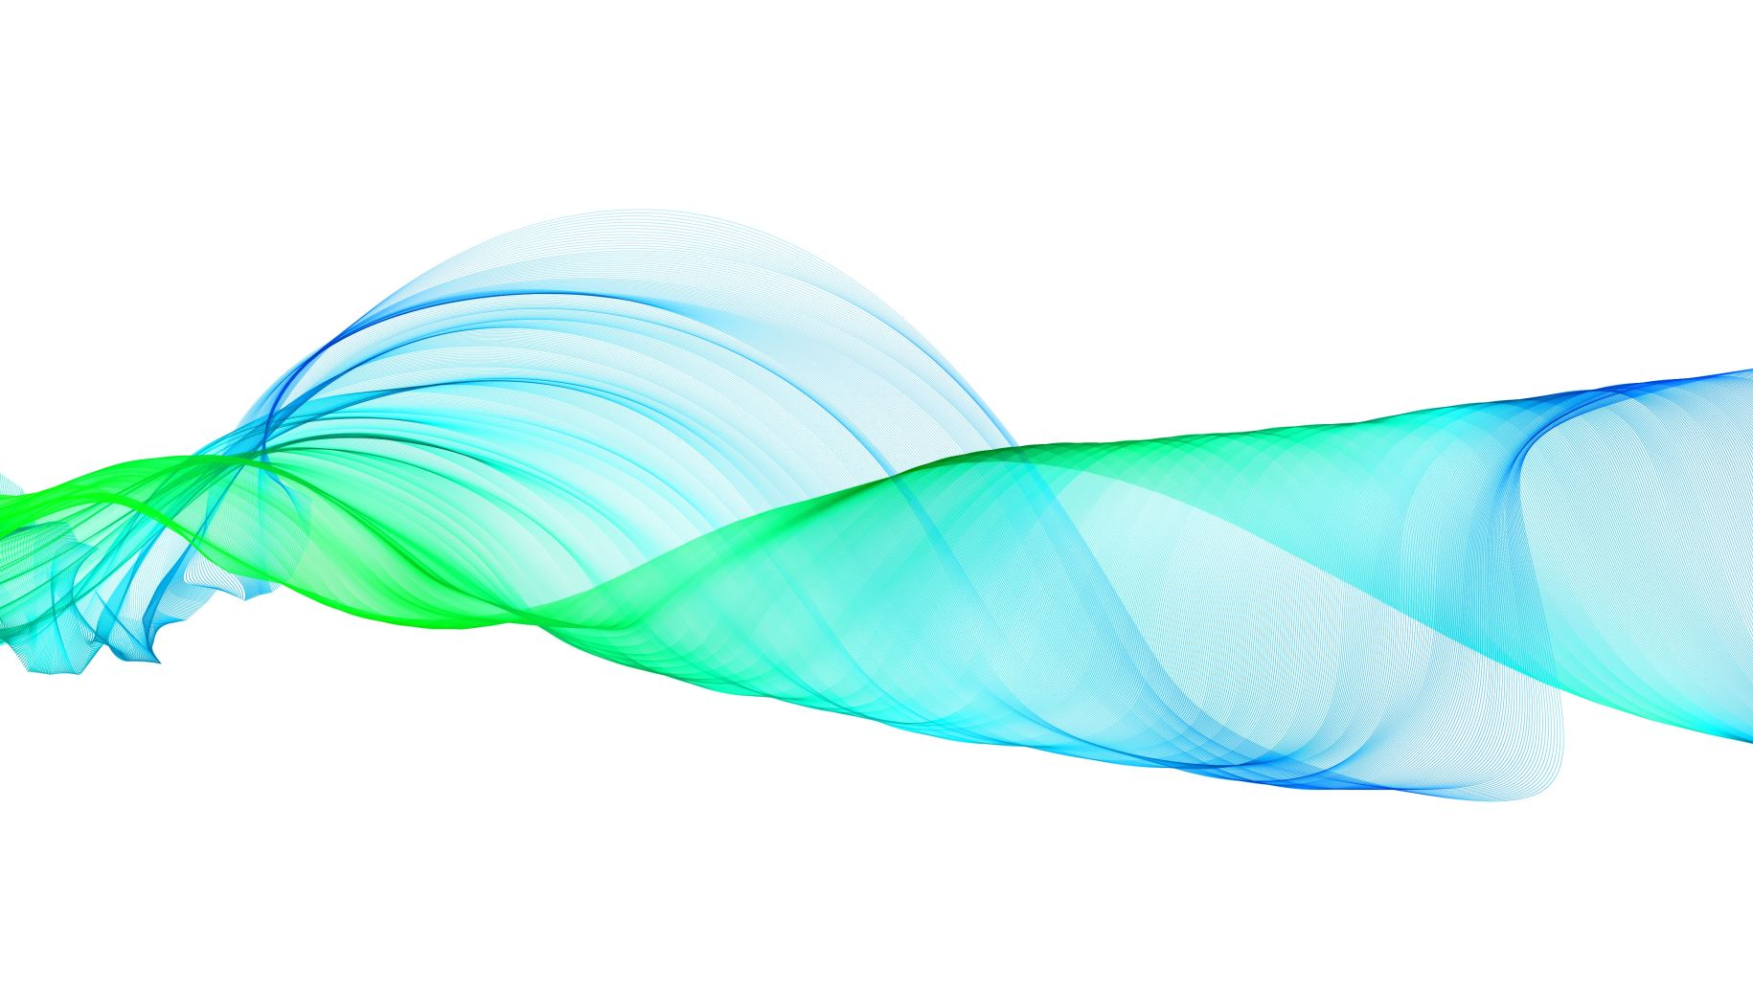
Deep Learning
Simply Explained

Slide 2
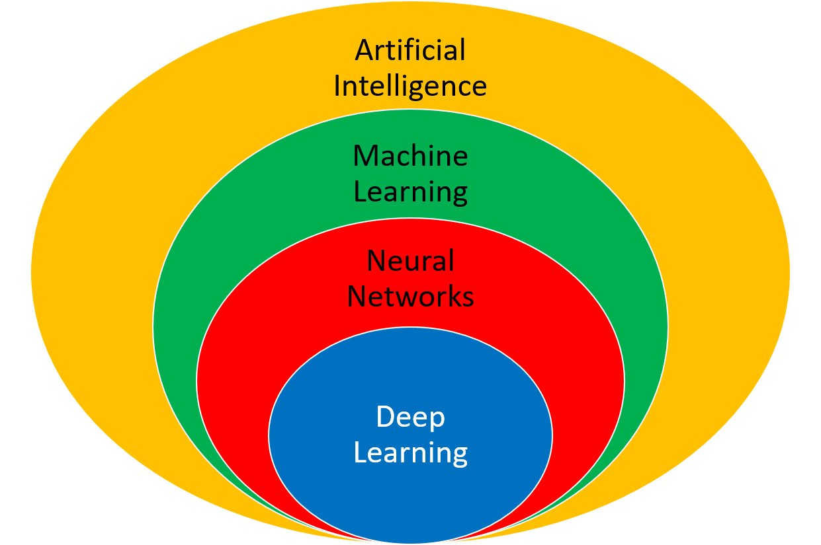
What is Deep Learning
Deep learning is a subset of machine learning, and the primary difference lies in the complexity of the models and the way they learn from data.

Slide 3

How is Deep Learning Different from Machine Learning

Slide 4
Hierarchy of Representations
Machine Learning: Traditional machine learning models, such as linear regression, decision trees, and support vector machines, often rely on manually engineered features.
Deep learning: Deep learning models, specifically neural networks, automatically learn hierarchical representations of data. Each layer in a neural network can learn increasingly complex features from the raw data

Slide 5
Feature Engineering
Machine Learning: In traditional machine learning, experts usually need to manually select and engineer relevant features from the data to represent patterns effectively.
Deep Learning: Neural networks are capable of learning relevant features from raw data during the training process, reducing the need for extensive manual feature engineering.

Slide 6

Model Complexity
Machine Learning
Machine Learning: Traditional models are generally simpler and have a limited capacity to capture complex relationships in data.
Deep Learning
Deep Learning: Neural networks, especially deep neural networks with many layers, can model highly complex and non-linear relationships in data.

Slide 7

Performance on Unstructured Data
Machine Learning: Traditional machine learning models may struggle with unstructured data like images, audio, and text.
1
Deep Learning: Deep learning excels in handling unstructured data and has shown remarkable performance in tasks such as image and speech recognition, natural language processing, and more.
2

Slide 8
Amount of Data
Machine Learning: Traditional models may require a significant amount of curated and preprocessed data to perform well.
Deep Learning: Deep learning models, particularly deep neural networks, can benefit from large amounts of data, and they often exhibit improved performance with more training examples.

Slide 9
Training and Computational Resources
Machine Learning
Machine Learning: Training traditional machine learning models might not require as much computational power compared to deep learning models.
Deep Learning
Deep Learning: Training deep neural networks can demand substantial computational resources, often requiring specialized hardware like GPUs or TPUs.

Slide 10
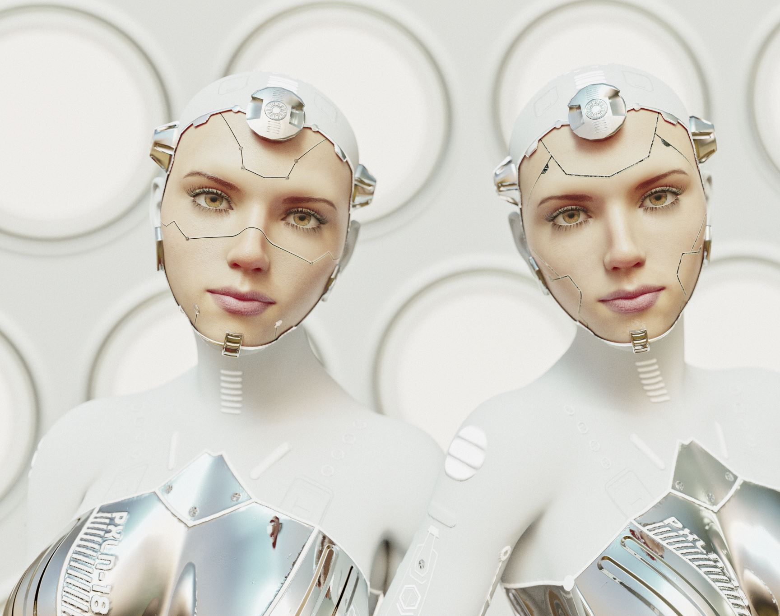
Neural Networks
The foundation of deep learning models

Slide 11

Model Representation
Input layer — initial data for the neural network.
Hidden layers — intermediate layer between input and output layer and place where all the computation is done.
Output layer — produce the result for given inputs.

Slide 12
Components of a Neural Network
A neural network consists of many simple processing elements called neurons, units, cells or nodes.
Each neuron is connected to other neurons by means of directed communication links, each with associated weight.
The weight represent information being used by the net to solve a problem.

Slide 13
Components of a Neural Network
Each neuron has an internal state, called its activation, which is a function of the inputs it has received. Typically, a neuron sends its activation as a signal to several other neurons.
It is important to note that a neuron can send only one signal at a time, although that signal is broadcast to several other neurons.

Slide 14
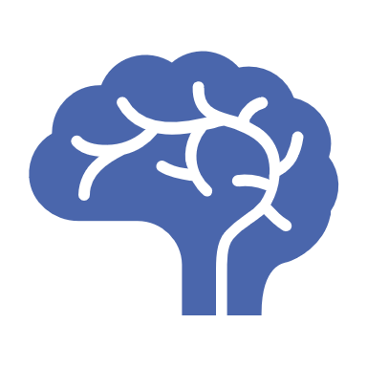
How does a Neural Network learn?

Slide 15
STEP 1:
When an input is given to the neural network, it returns an output. On the first try, it can’t get the right output by its own (except with luck) and that is why, during the learning phase, every inputs come with its label, explaining what output the neural network should have guessed.

Slide 16
STEP 2:
If the choice is the good one, actual parameters are kept, and the next input is given. However, if the obtained output doesn’t match the label, weights are changed. Those are the only variables that can be changed during the learning phase.

Slide 17
STEP 3:
To determine which weight is better to modify, a particular process, called “backpropagation” is done.
It consists of going back on the neural network and inspect every connection to check how the output would behave according to a change on the weight.

Slide 18


Slide 19
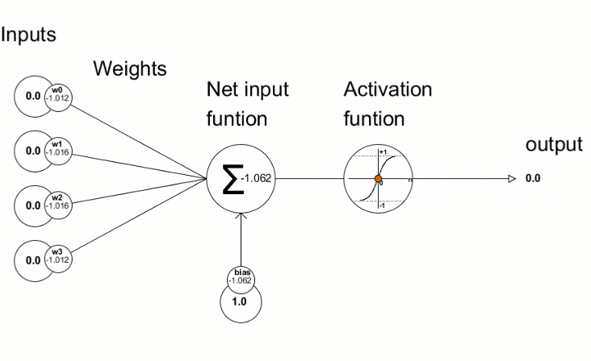
Visualizing the neural network

Slide 20
Let’s understand with a simple example

Slide 21

Predict the image is of a tiger or not
There is a group of 10 people (Person A to Person J) who want to make a model which predicts that a particular image is of a tiger or not

Slide 22
Task distribution
Person A focuses on the eyes.
Person B specializes in patterns around the ears.
Person C analyzes the mouth.
Person D observes the nose.
Person E looks for patterns in the tail.
Person F examines the paws.
Person G studies body patterns.
Person H takes inputs from Persons A to D and processes information related to facial features.
Person I takes inputs from Persons E to G and processes information related to body features.
Person J combines the information from Persons H and I to make the final prediction about whether the image contains a tiger or not.

Slide 23
How do people show their prediction
Each person gives rating from 0 to 1, where 1 means he/ she is 100% sure that the pattern belongs to tiger and 0 means he/ she is 100% sure that the pattern doesn't belong to tiger
Any rating in between is the respective probability in his decision of the pattern. For example, if he gives rating as 0.5, then it means he is equally confused between the pattern belonging to a tiger and not belonging to a tiger

Slide 24
Facial Features (Input Layer)
Facial Features
A
B
C
D
Towards H

Slide 25
Body Feature Group (Input Layer)
Body Features
E
F
G
Towards I

Slide 26
The Hidden Layer
Facial Features
A
B
C
D
Towards H
Body Features
E
F
G
Towards I

Slide 27
The Final Decision Maker (Output Layer)
Final Decision
H
I
Towards J

Slide 28
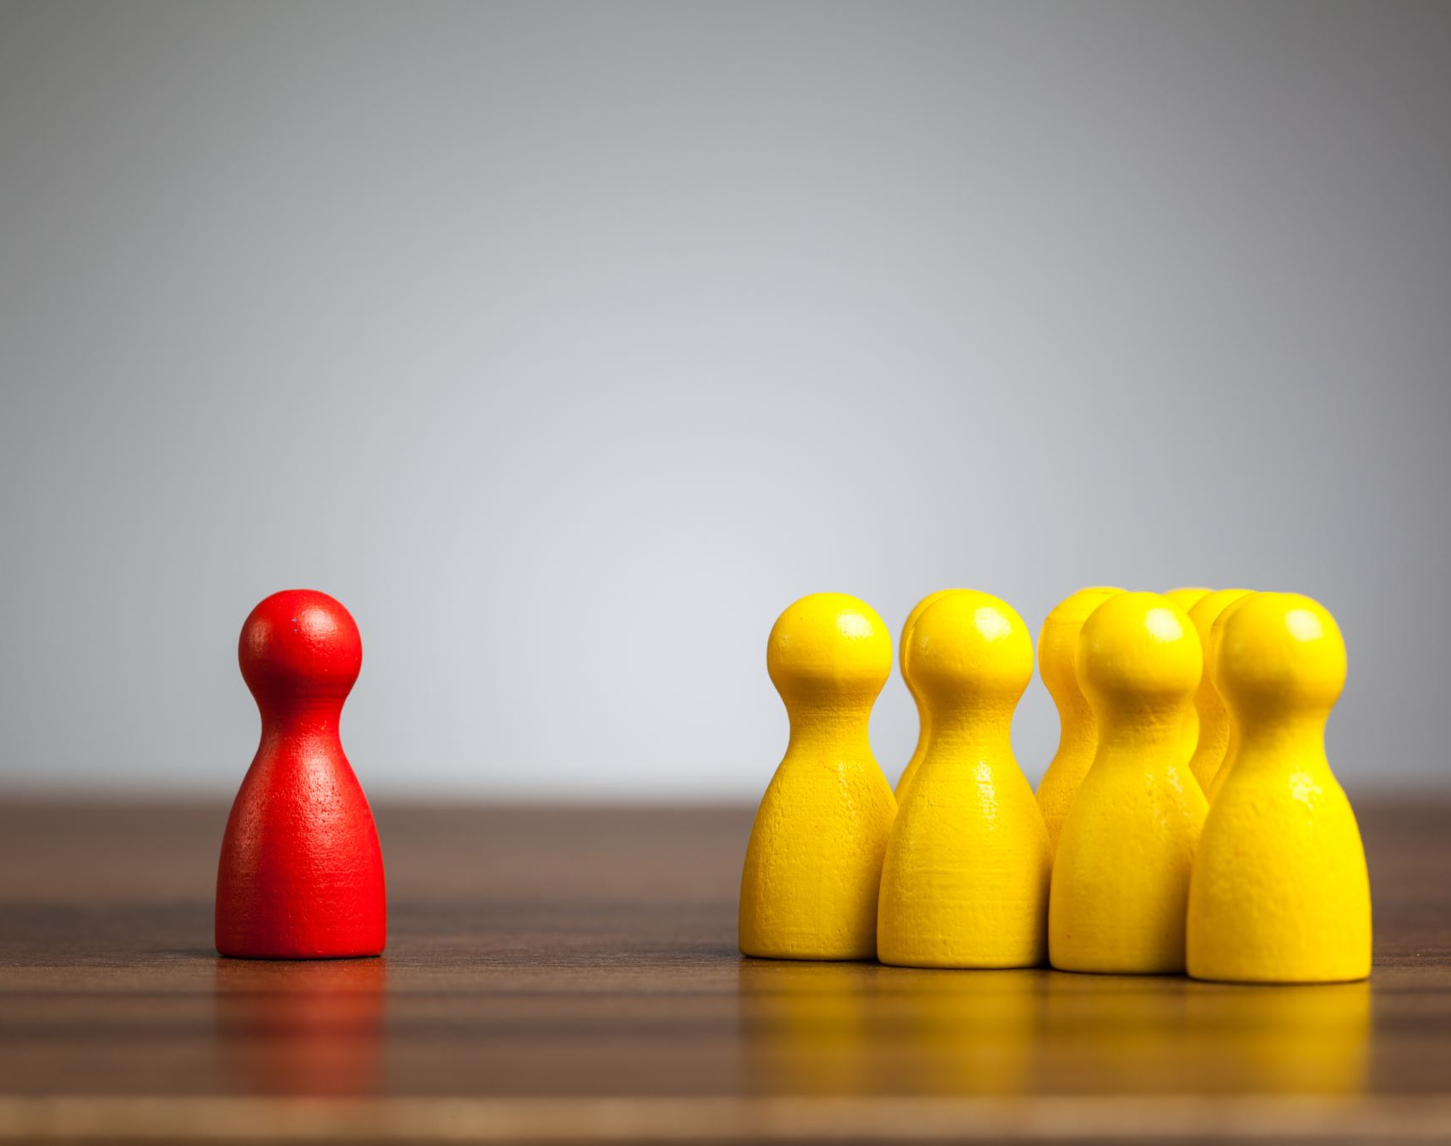
How is the prediction made

Slide 29
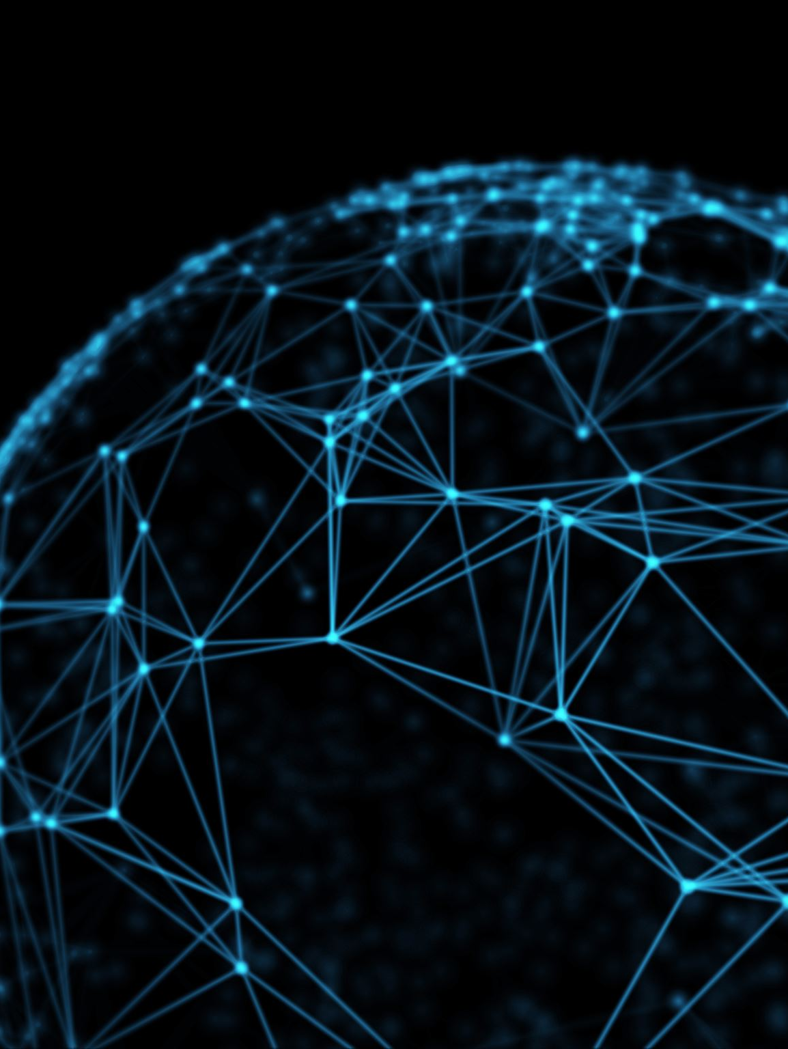
The flow of predictions across the network is :
The image is presented to Persons A to G.
Persons A to D send their individual predictions to Person H in the hidden layer, and Persons E to G send their predictions to Person I in the hidden layer.
Persons H and I process the information from their respective groups and send their outputs to Person J in the output layer.
Person J combines the information from both the facial and body features to make the final decision on whether the image is of a tiger or not.

Slide 30
Step 1 : Prediction by A, B, C, D, E, F and G
Let’s say the respective scores given by A, B, C, D, E, F and G are x1, x2,x3,x4,x5,x6 and x7 where each value variable is between 0 and 1
They transfer their scores to H and I respectively

Slide 31
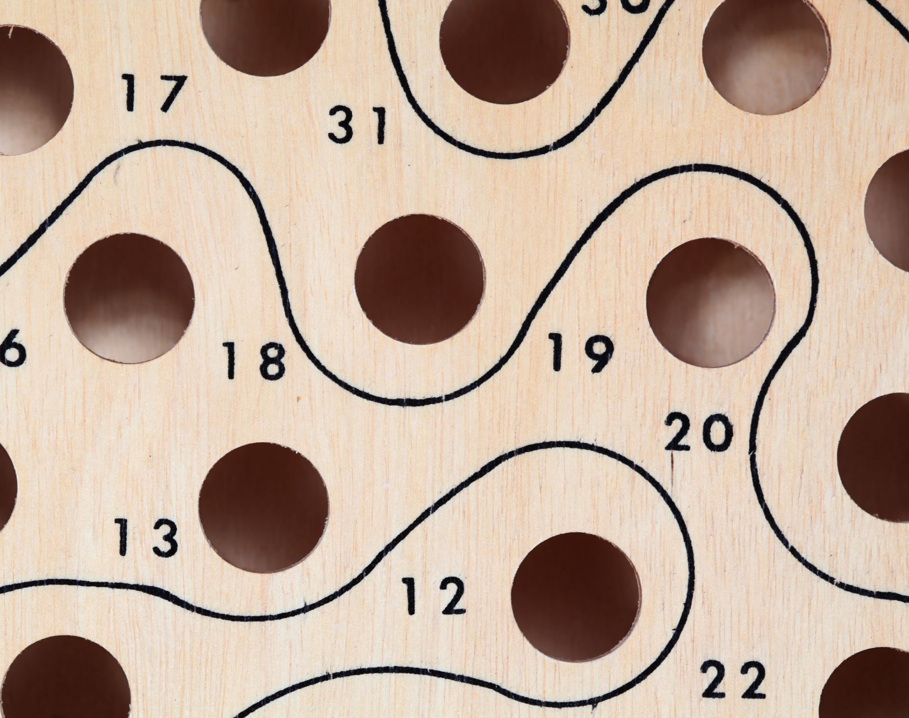
What does H do?
H prepares its own score by adding different weights to the respective scores of A, B, C, D
Score by H (lets say x8) =
0.2*x1+0.2*x2+0.3*x3+0.3*x4

Slide 32
What does I do?
I prepares its own score by adding different weights to the respective scores of E, F and G
Score by I (lets say x9) =
0.3*x1+0.1*x2+0.6*x7

Slide 33
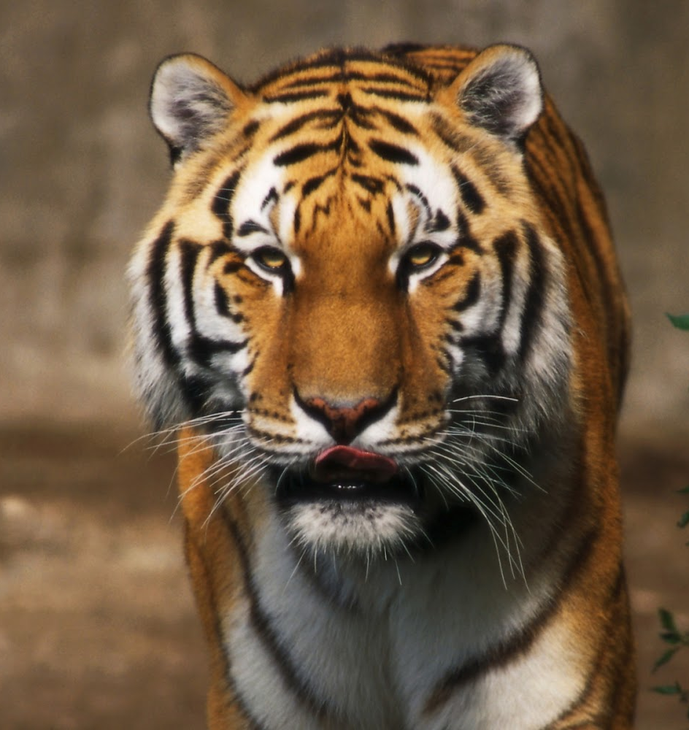
How does J predict the final image
Person J combines the results from Person H and Person I by attaching different weights to their results
Score by J (lets call it x10) = 0.6 *x8 + 0.4*x9
If x10 is more than 0.5, the model predicts that the image is of a tiger

Slide 34
Steps to train the DL model
STEP 1:
First of all, an image is given to A, B, C, D, E, F and G. Each of them give their random predictions. Based on their predictions, H and I and subsequently J makes predictions
STEP 2 :
If the choice is the good one, actual weights and scores are kept, and the next image is given. However, if the obtained output is not as correct, weights are changed. Those are the only variables that can be changed during the learning phase.
STEP 3 :
To determine which weight is better to modify, a particular process, called “backpropagation” is done. It consists of going back on the neural network and inspect every connection to check how the output would behave according to a change on the weight.

Slide 35
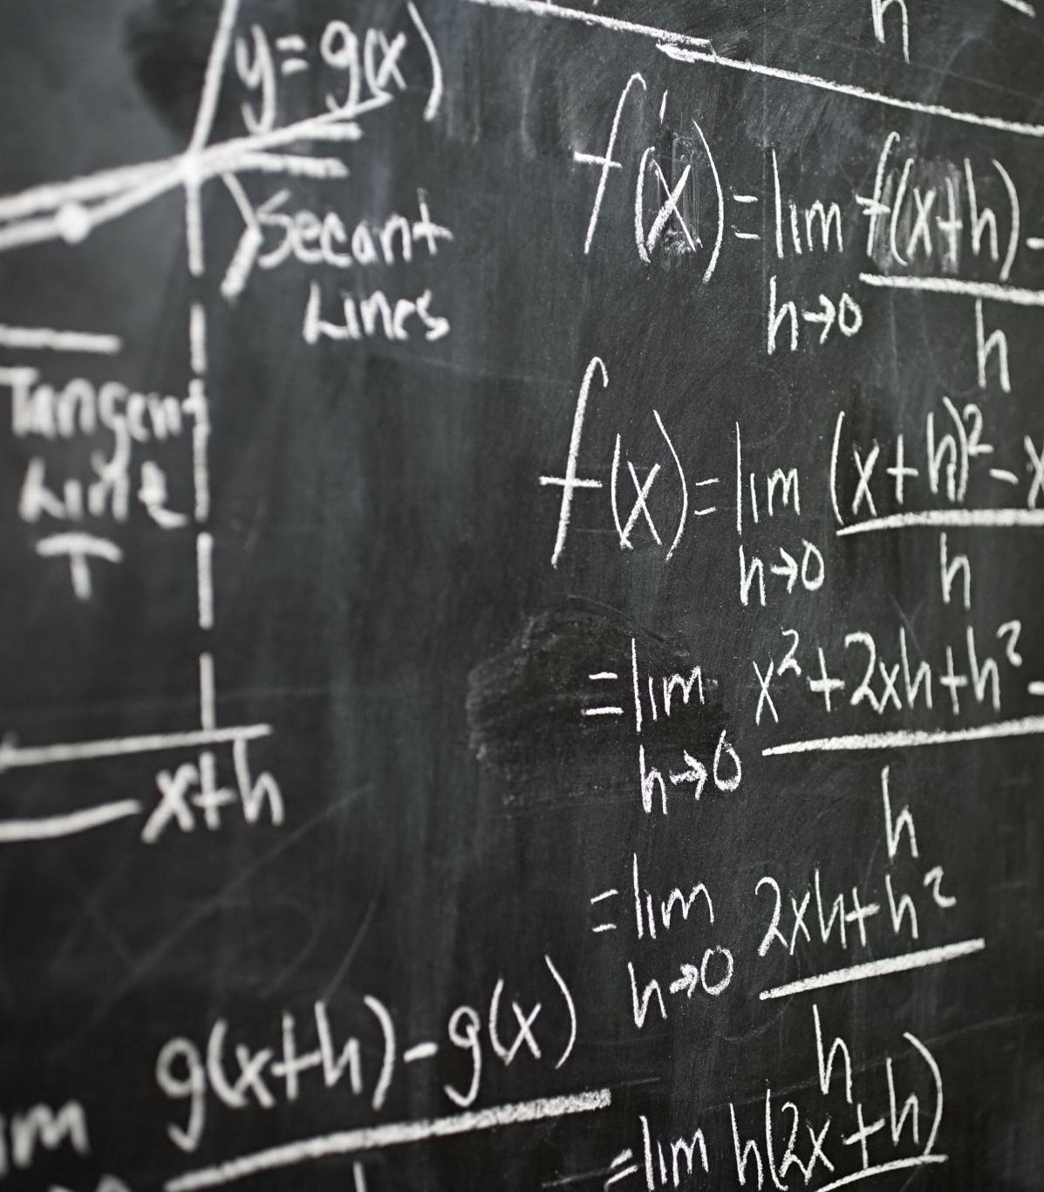
Components of Deep Learning

Slide 36
Key Components of a Deep Learning Model
Neural Networks
Deep Neural Networks
Training and Backpropagation
Architectures
Activation Functions
Pretrained Models and Transfer Learning

Slide 37
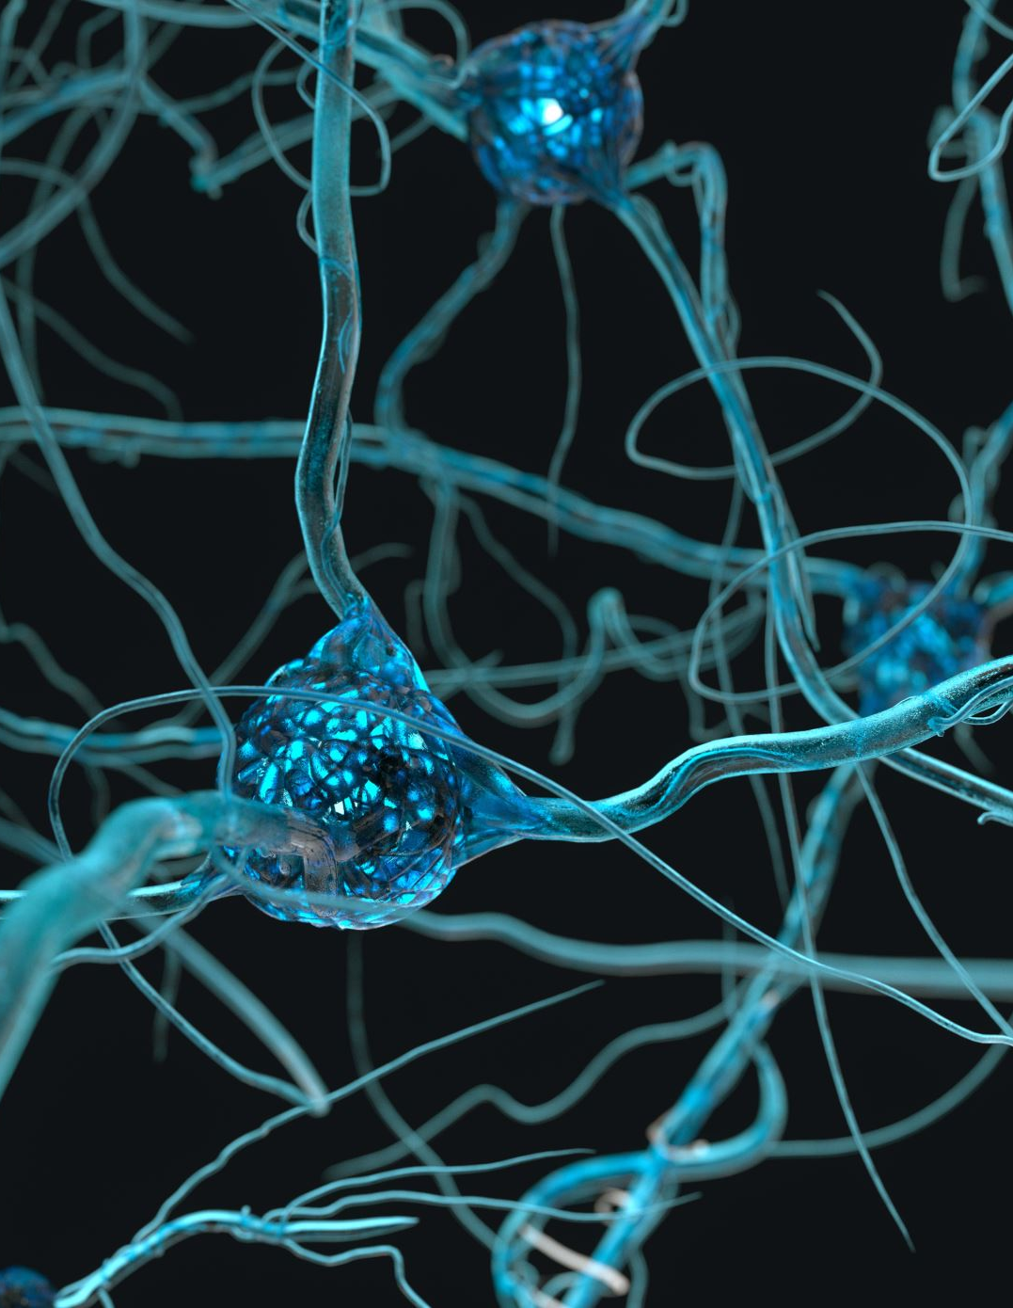
Neural Networks
Neural networks consist of interconnected nodes (neurons) organized into layers. There are typically three types of layers: input layer, hidden layers, and output layer.
Neurons in one layer are connected to neurons in the next layer, and each connection has a weight that is adjusted during training.
Activation functions introduce non-linearity to the model, allowing it to learn complex patterns.

Slide 38
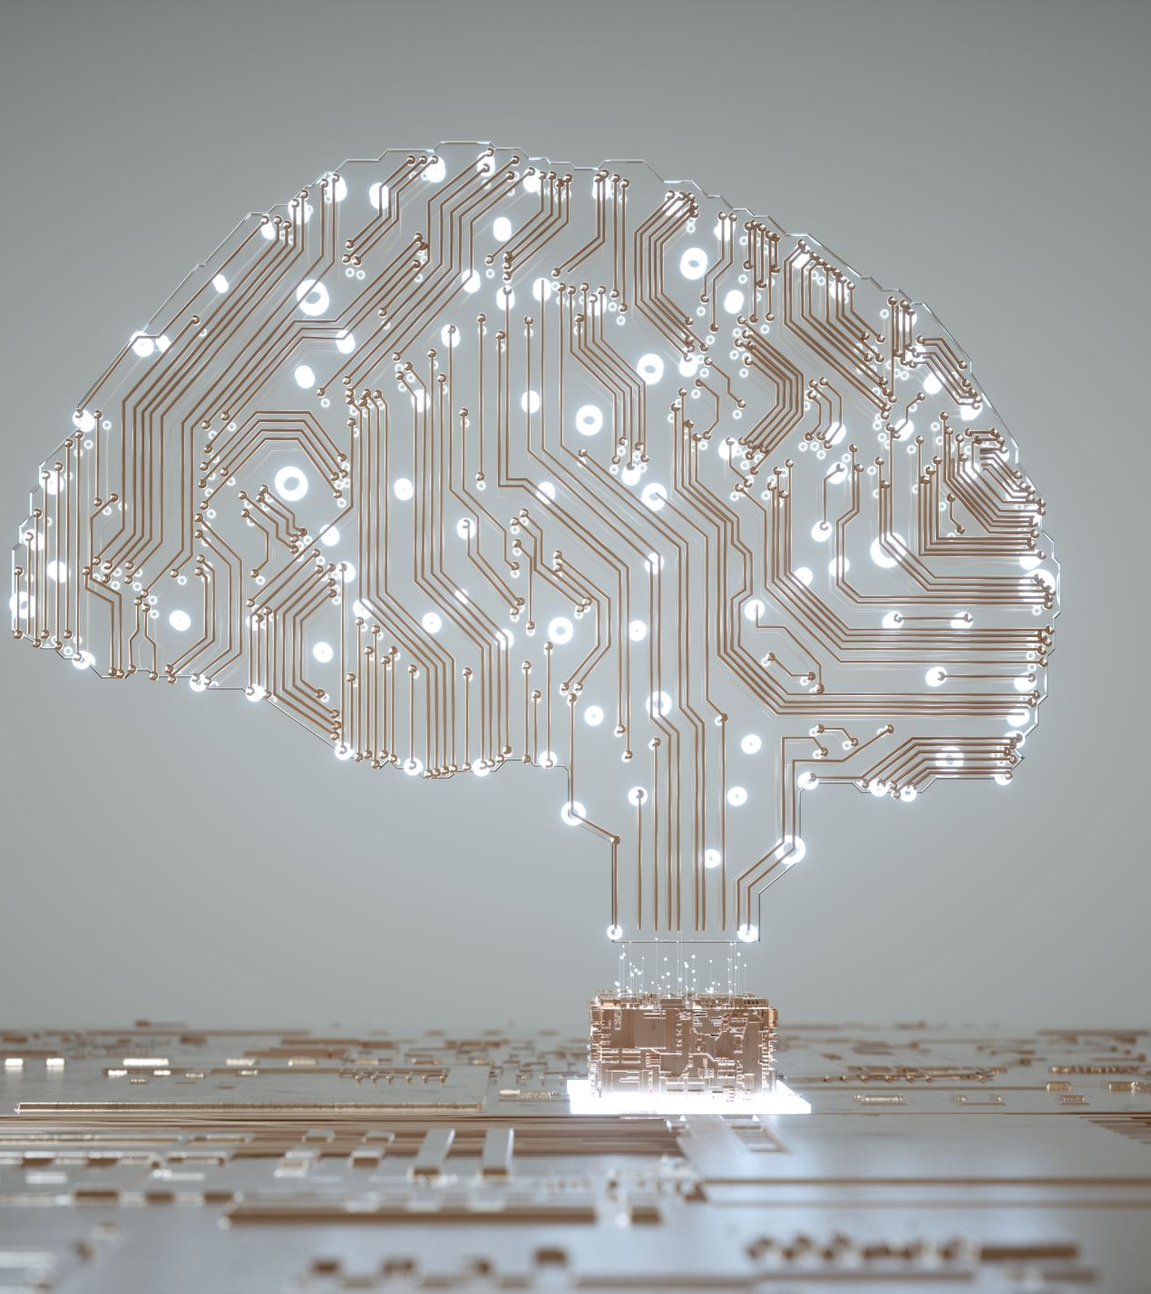
Deep Neural Networks
Deep learning involves the use of deep neural networks, which means networks with multiple hidden layers.
The term "deep" comes from the depth of the network, and having multiple layers enables the model to learn hierarchical representations of data

Slide 39

Training and Backpropagation
Deep learning models are trained using a process called backpropagation. During training, the model makes predictions, and the error between predictions and actual values is used to update the weights in the network to reduce the error.
Optimization algorithms, such as gradient descent, are commonly used to minimize the error or loss function.

Slide 40
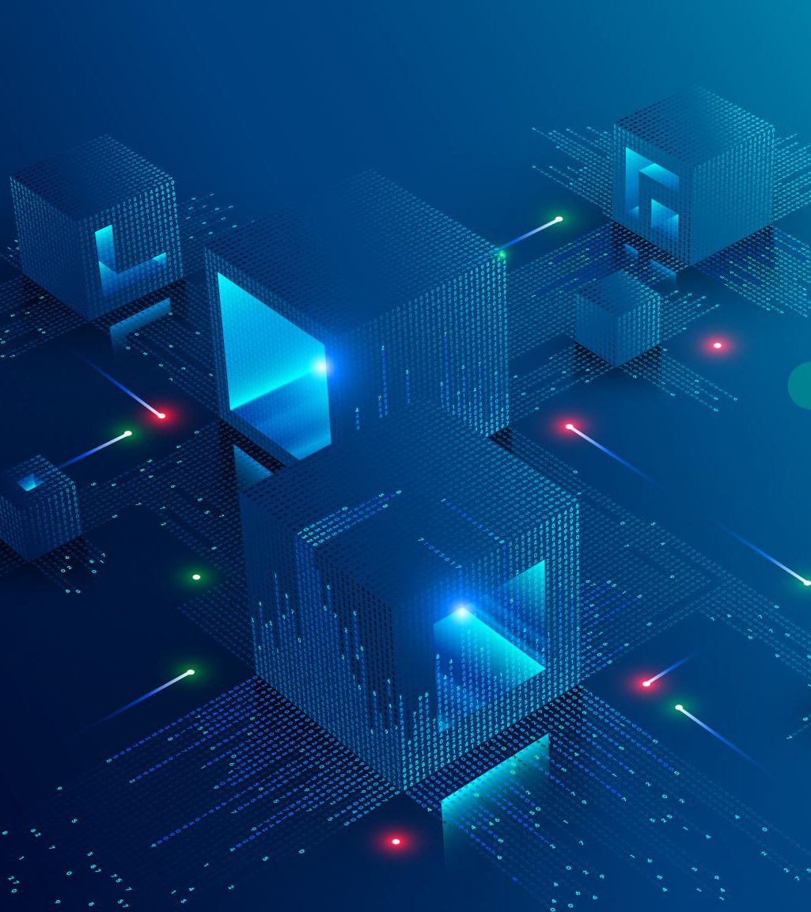
Architectures
Different neural network architectures are designed for specific tasks. For example, convolutional neural networks (CNNs) are used for image-related tasks, recurrent neural networks (RNNs) for sequential data, and transformer architectures for natural language processing.

Slide 41
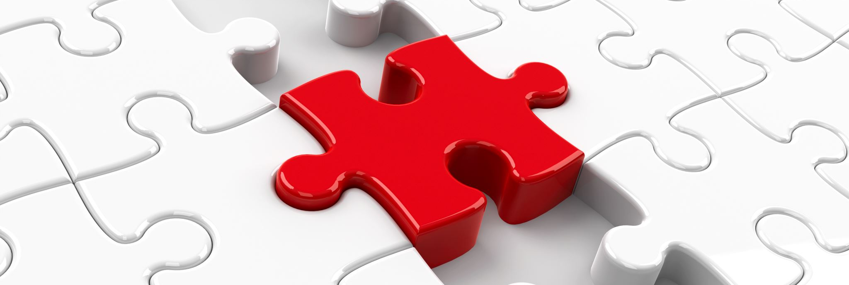
Activation Functions
Activation functions introduce non-linearities to the model, allowing it to learn and represent complex relationships in the data.
Common activation functions include sigmoid, tanh, and rectified linear unit (ReLU).

Slide 42
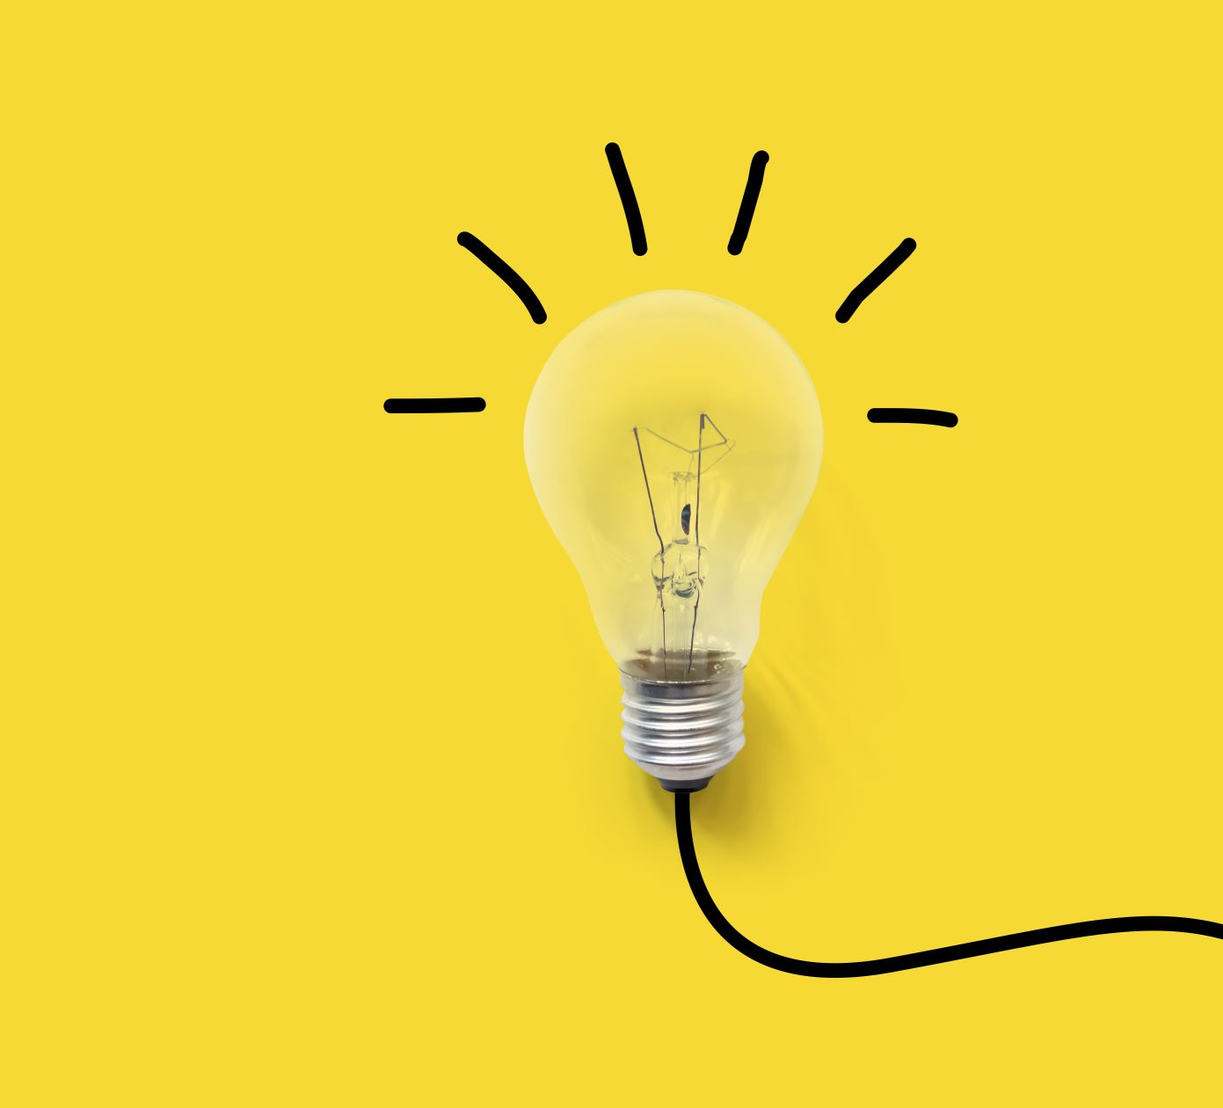
Pretrained Models and Transfer Learning
In many applications, models are pretrained on large datasets before being fine-tuned for specific tasks. Transfer learning involves leveraging the knowledge gained during pretraining.

Slide 43
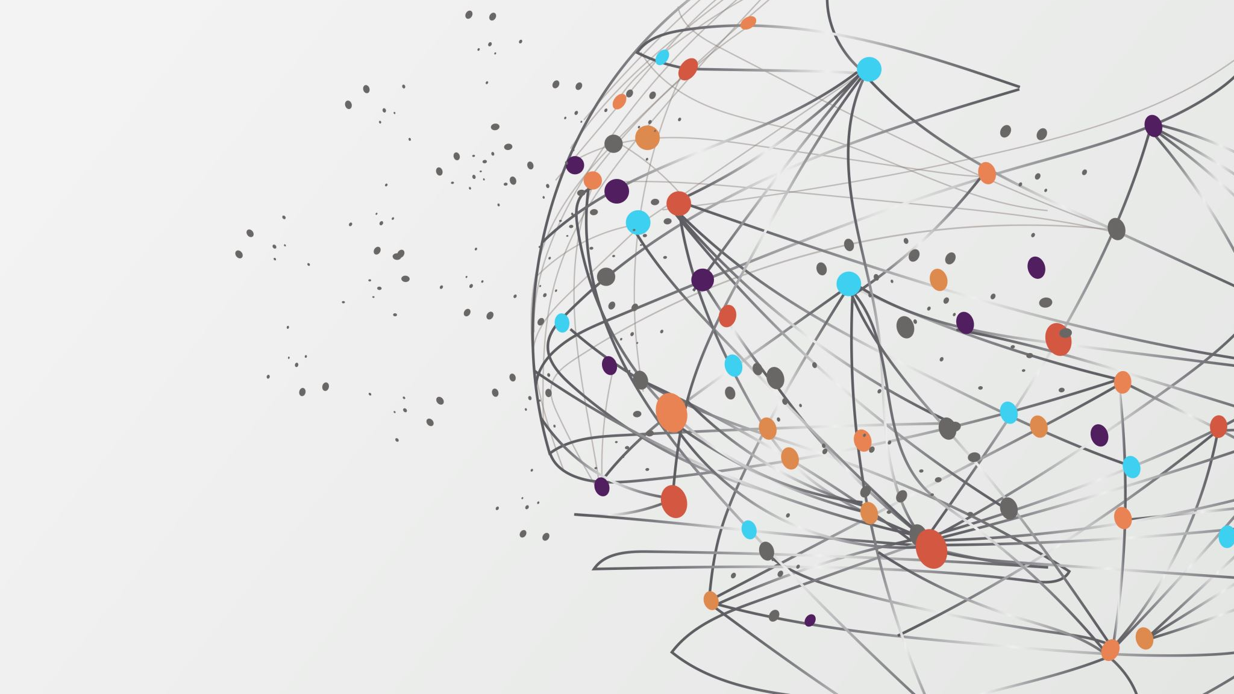
Applications of Deep Learning

Slide 44
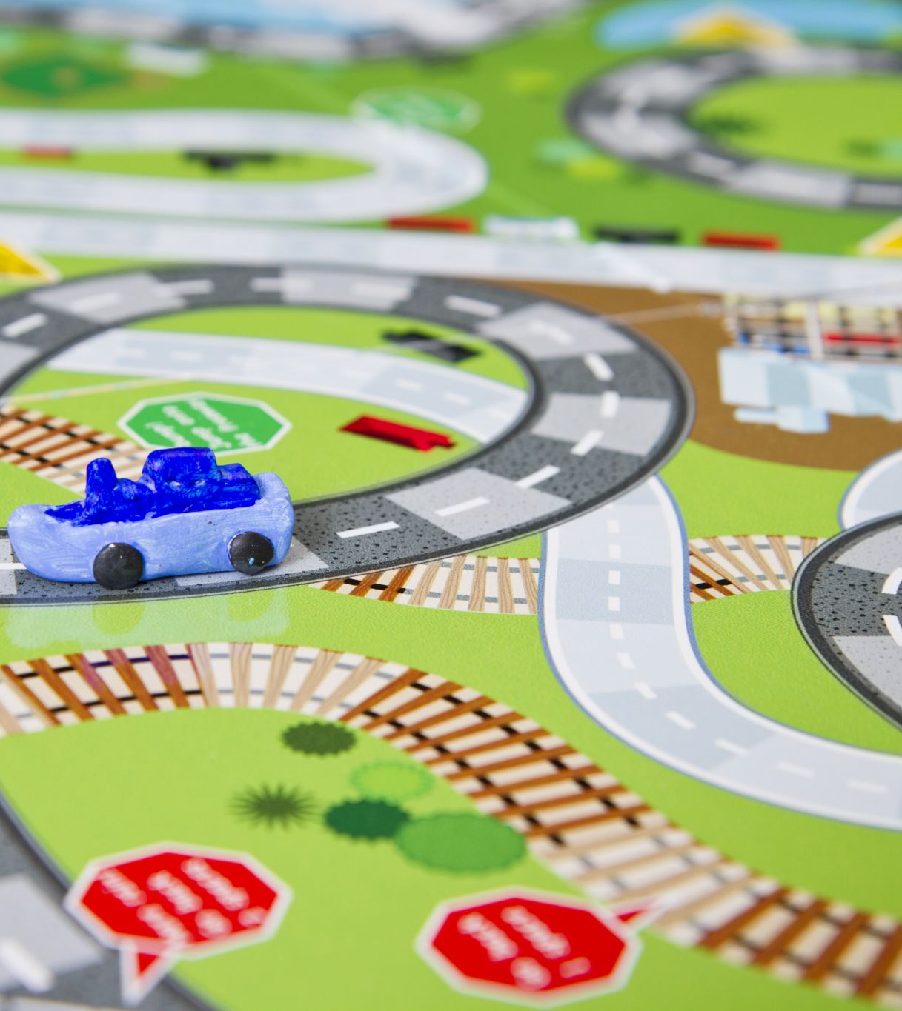
Self Driving Cars
Deep Learning is the force that is bringing autonomous driving to life. A million sets of data are fed to a system to build a model, to train the machines to learn, and then test the results in a safe environment.

Slide 45
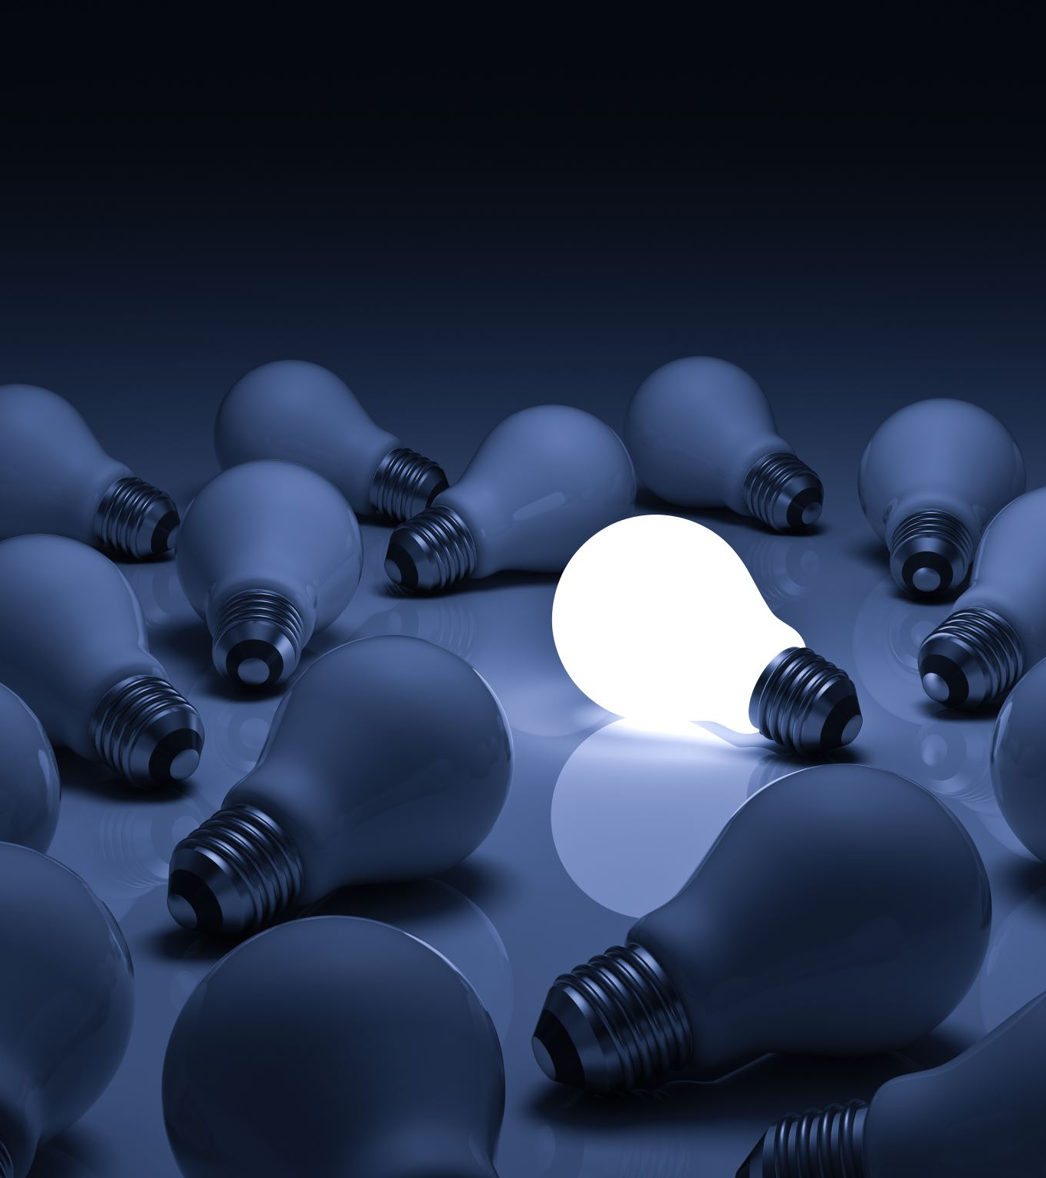
Virtual Assistants
The most popular application of deep learning is virtual assistants ranging from Alexa to Siri to Google Assistant. Each interaction with these assistants provides them with an opportunity to learn more about your voice and accent, thereby providing you a secondary human interaction experience.

Slide 46

Visual Recognition
Images can be sorted based on locations detected in photographs, faces, a combination of people, or according to events, dates, etc. Searching for a particular photo from a library

Slide 47
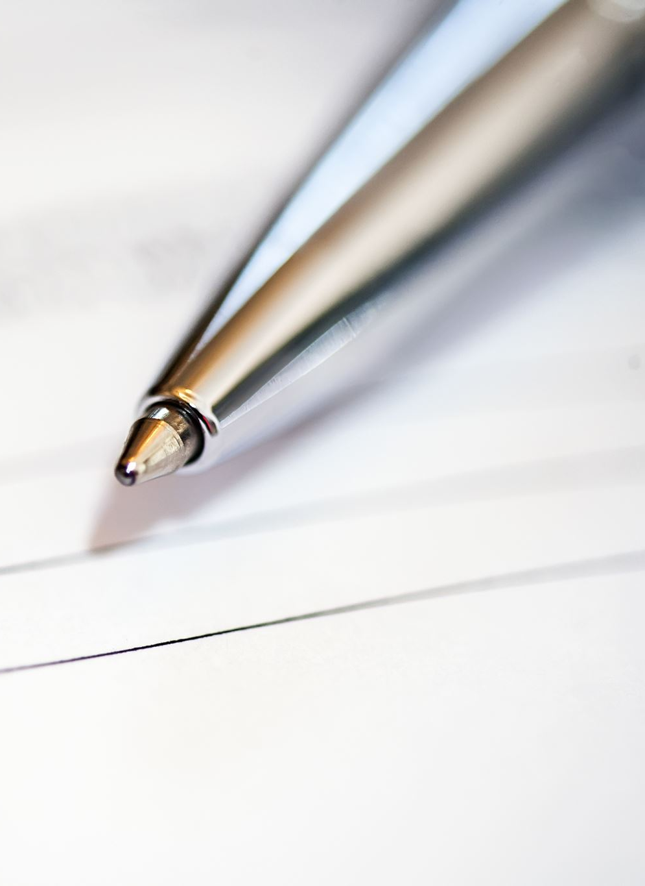
Text Analysis and Understanding
Document classification, sentiment analysis, automatic translation are some of the areas where this is used today.

Slide 48

THANK YOU!

